Slide 1

Fundamentals: Cantu Hair Care
Tshepiso Precious Khoarane
QA Trainee Consultant

Slide 2

Scope
BOSCARD
Risk Assessment
Trello Board
Project

Slide 3
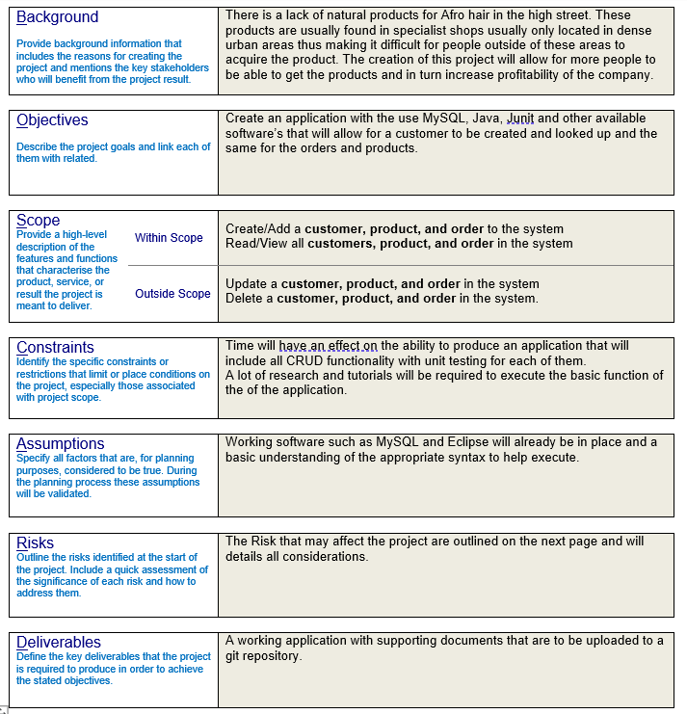
BOSCARD
What is a BOSCARD ?
It is a tool that can be used to bolster support when commencing a new project.
It is important that all stakeholders that are affected by the project are involved, are aware with considerable detail what the project is to achieve before it starts. Not doing this may lead to failures along the timeline of the project.

Slide 4
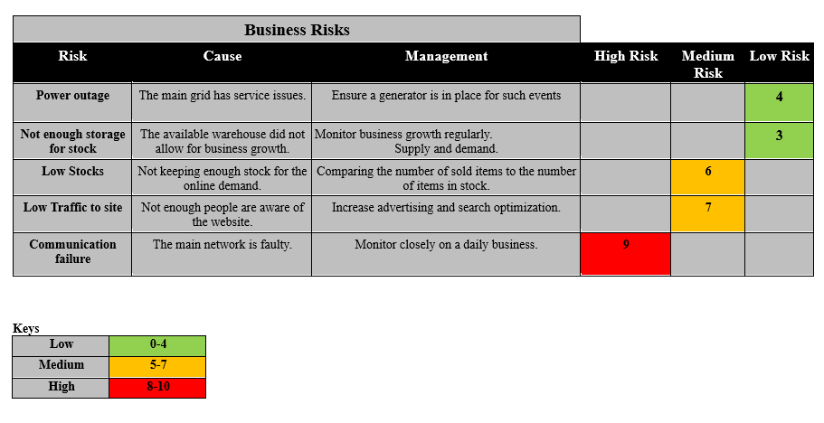
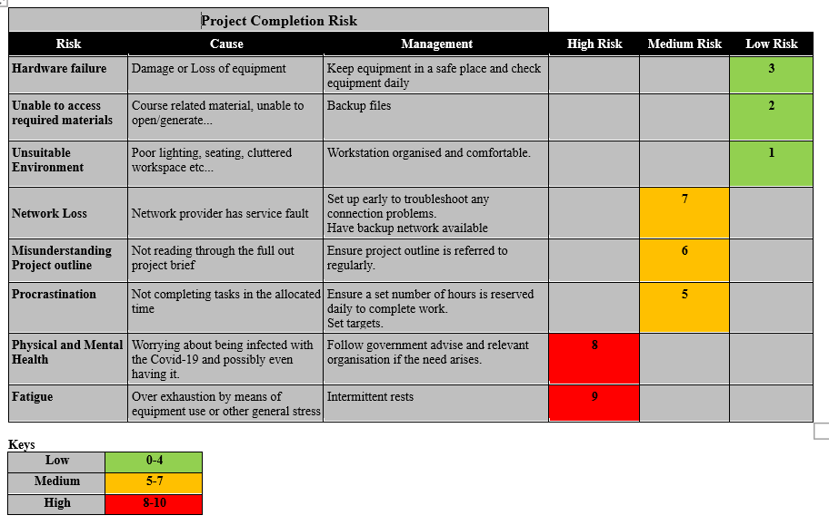
Risk Assessments
When commencing a project there are always risks that may occur that need to be taken into consideration.
Having a risk assessment in place will help with foreseeing and preplanning for the any risks.

Slide 5
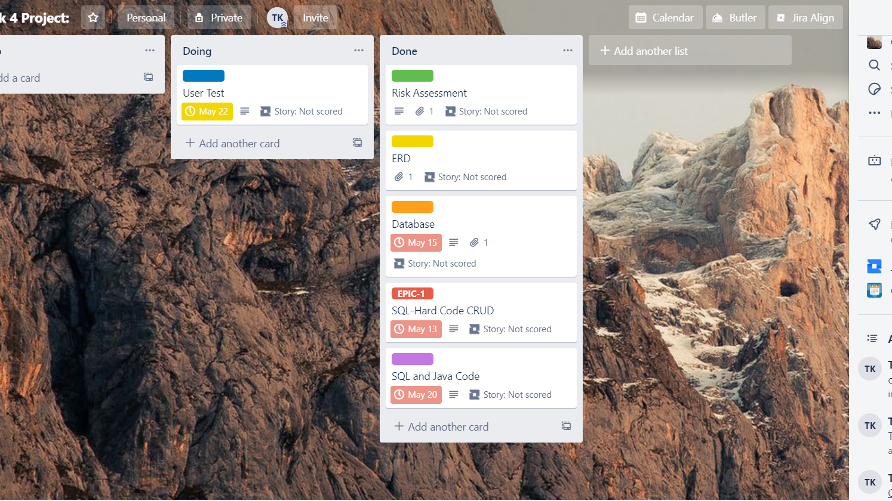
Agile Working
Creating an agile work environment allows for all stakeholders and project participants to be able to keep track of tasks that have been completed and those still scheduled to be done. A Trello board facilitates this activity very well, it helps you keep track of deadlines, assignments and burndown chart.

Slide 6
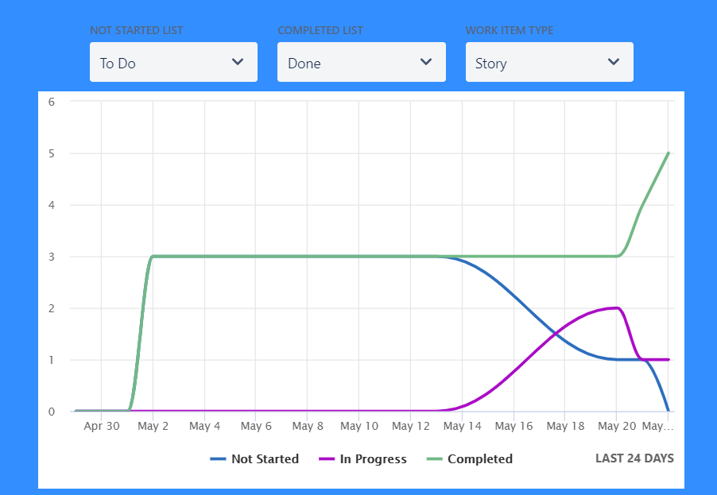
Cumulative Chart

Slide 7
Project
Database
ERD
Application
Demonstration
Unit Testing

Slide 8
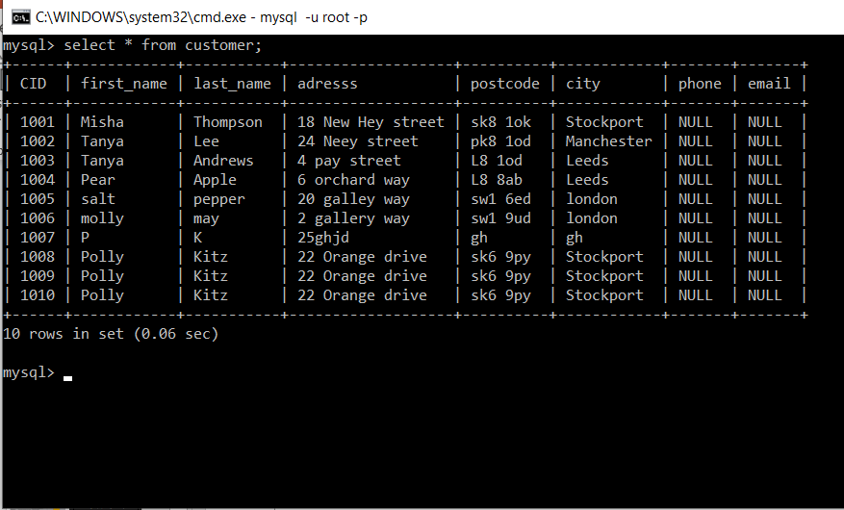
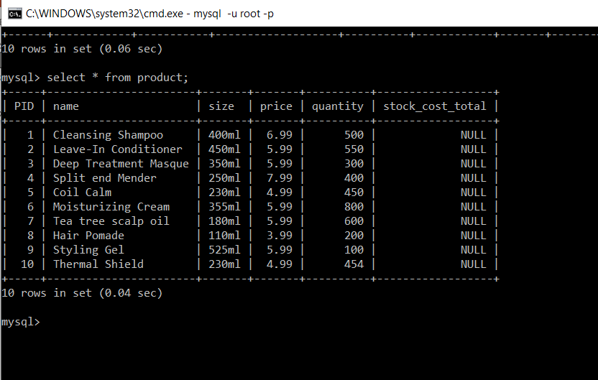
Database
In order to start this project a databases was needed; this was done using MySQL cmd.
The database comprised of 3 Tables labelled as follows:
Customer
Products
Orders
These tables where then filled with dummy data to test that they had been constructed correctly.

Slide 9
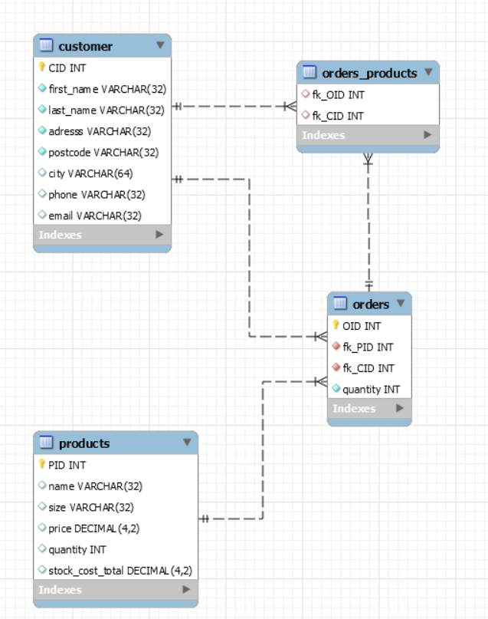
ERD (entity relationship diagram)
An Entity Relationship Diagram shows entities also known as tables in a database and how they relate to each other within the database. It is always good practice in database design to include an Entity Relationship Diagram, as I will allow the business to clearly see how data from one table affects the data required in another.

Slide 10
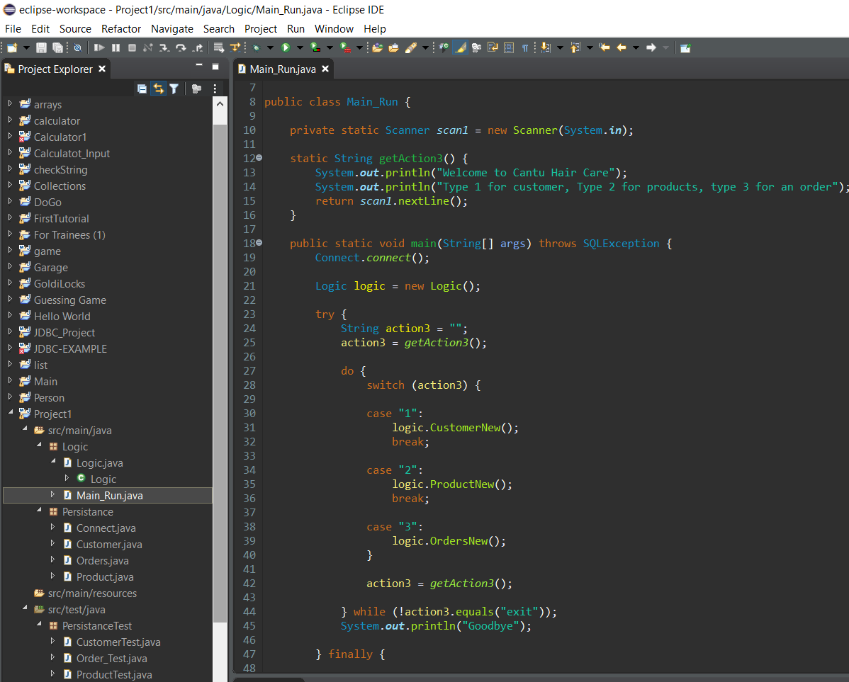
Application
The project application will be run on the Eclipse software. This software was also used to write the code that runs the application.
The application requires an input from the user on the console.

Slide 11
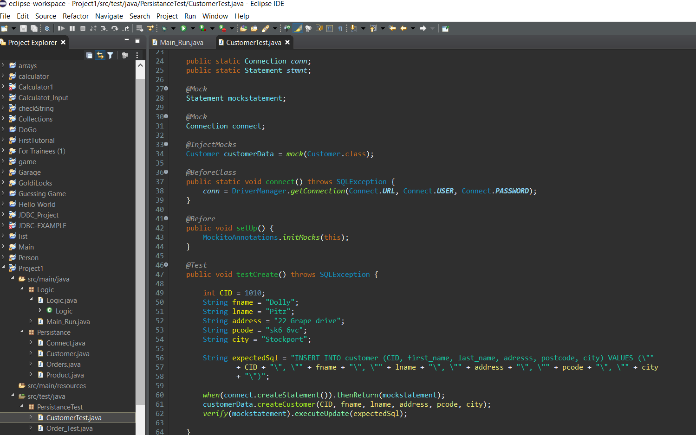
Unit Testing
Unit testing is defined as a software testing method by which individual units of source code, together with associated control data are tested to determine whether they are fit for use. A unit is the smallest testable part of any software. It usually has one or a few inputs and usually a single output.

Slide 12
Reflection
Whilst completing this project I have learned a number of new technologies, that have greatly enhanced my previous understanding of coding and how it can be implemented.
There has been some stumbling boards which some I have managed to overcome and other need work on.
The app is able to connect to the MySQL database and execute the statements as required but unfortunately, I was not able to get the unit testing to complete. In order to get over this hurdle I will be completing more unit testing tutorials using different scenarios to strengthen my knowledge in this area.
Any Questions?

